Slide 1
Decision Trees
Lecture 7

Slide 2
Graphviz package installed on python

Slide 3
Friday, August 30th
National Beach Day
National Toasted Marshmallow Day

Slide 4
Lecture Resources
I'm relying heavily on this one: https://machinelearningmastery.com/what-is-information-entropy/
https://victorzhou.com/blog/information-gain/
https://www.tutorialspoint.com/difference-between-entropy-and-information-gain
https://pro.arcgis.com/en/pro-app/latest/tool-reference/geoai/how-decision-tree-classification-and-regression-works.htm
https://kindsonthegenius.com/blog/how-to-build-a-decision-tree-for-classification-step-by-step-procedure-using-entropy-and-gain/

Slide 5
Information Theory
We are going to need to learn some concepts in this first before we talk about decision trees
Probability is going to underlie these concepts, as before with Bayes
Information Theory is a lot about quantifying uncertainty – looking at how 'surprising' or 'unsurprising' an event is
Developed by Claude Shannon at Bell Labs

Slide 6
Let's look at some levels of surprise
Tomorrow, the sun will rise
Tomorrow, it will be cloudy
Tomorrow, you will be attacked by wolverines

Slide 7
Let's look at some levels of surprise
Tomorrow, the sun will rise
  Not surprising. Basically guaranteed to happen.
Tomorrow, it will be cloudy
  Maybe surprising, maybe not – this time of year in CDA, about equal chance of sunny/cloudy
Tomorrow, you will be attacked by wolverines
  Very surprising

Slide 8
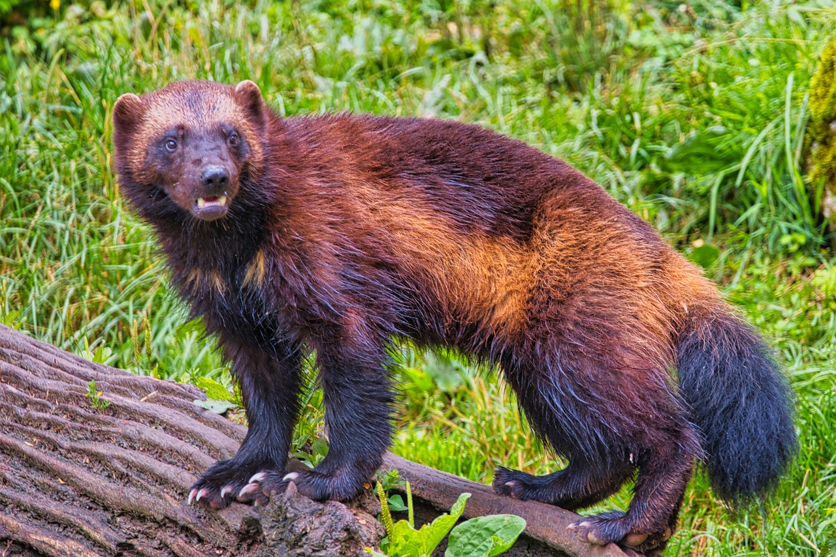
Let's look at some levels of surprise
Tomorrow, the sun will rise
  Not surprising. Basically guaranteed to happen. (Low information)
Tomorrow, it will be cloudy
  Maybe surprising, maybe not – this time of year in CDA, about equal chance of sunny/cloudy (Medium information)
Tomorrow, you will be attacked by wolverines
  Very surprising (High information. You'll probably make the paper.)

Slide 9
Calculating the Information of an Event
We can calculate the information of an event:
Information of event x = -log(p(x))
Using log base 2
We can see there is an inverse relationship between information of an event and probability
Sun will rise tomorrow: 100% probability, 0 information
Tomorrow will be cloudy, 50% probability, 0.301 information
You will be attacked by wolverines (let's say 1 in 1 million): 6 information
Information often written as h(x)
Information always >= 0
Source: https://machinelearningmastery.com/what-is-information-entropy/

Slide 10
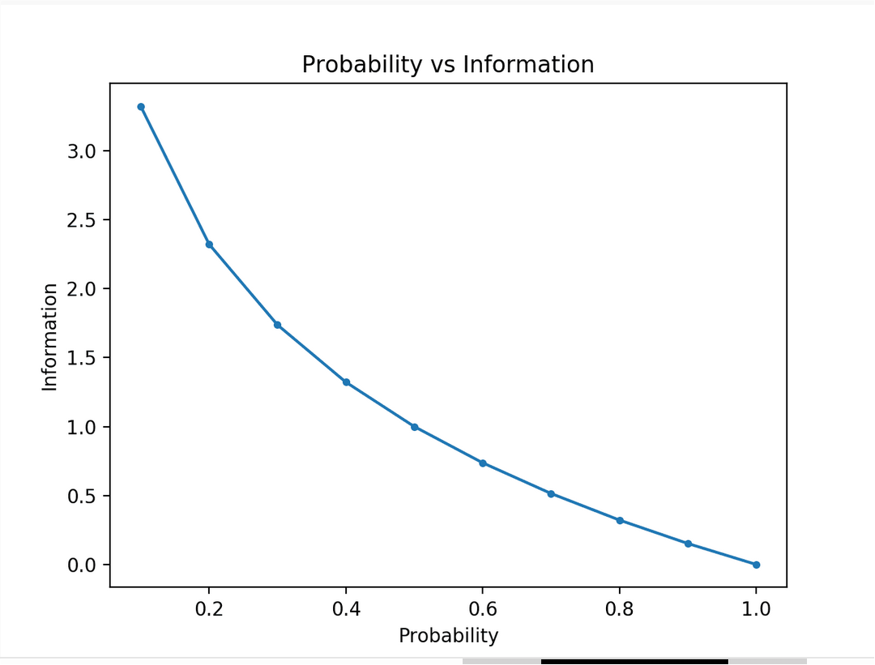
Source: https://machinelearningmastery.com/what-is-information-entropy/

Slide 11
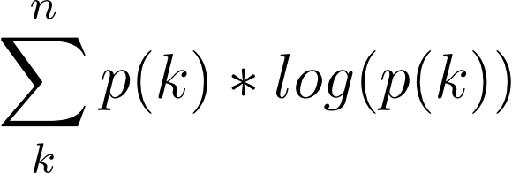
Entropy
Sometimes also called Shannon Entropy, fyi
How much information is in a random variable – basically looks at the variance of the random variable
Random variable x
K states in x
N instances of random variable x
Entropy of x =
Source: https://machinelearningmastery.com/what-is-information-entropy/

Slide 12
Entropy
Entropy gives you basically a measure of the average information in your distribution of the variable
Low entropy for average unsurprising distributions
High entropy for average surprising distributions
A balanced dataset has higher entropy than a very skewed one
Source: https://machinelearningmastery.com/what-is-information-entropy/

Slide 13
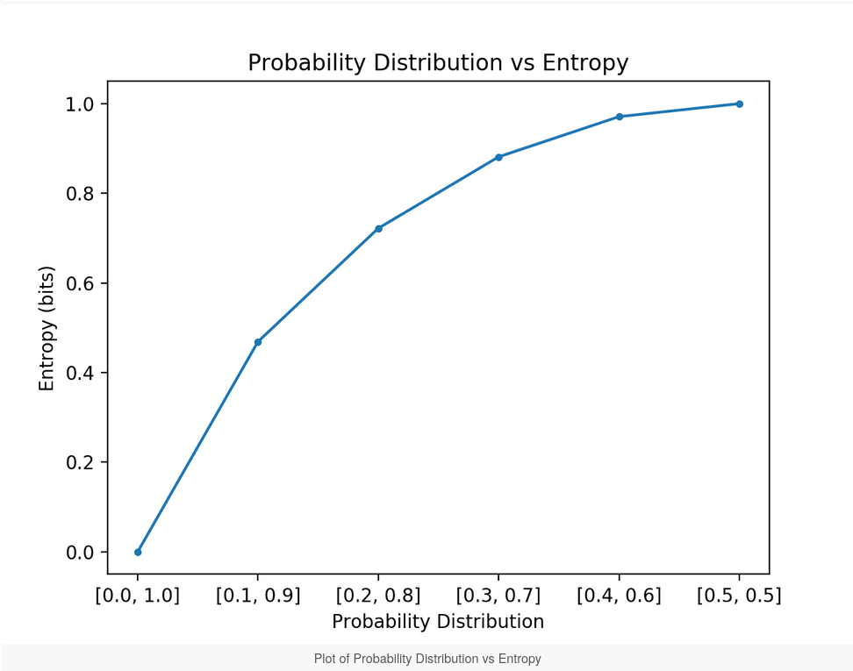
Source: https://machinelearningmastery.com/what-is-information-entropy/

Slide 14
Entropy
Information gain = Entropy removed
That will come in handy for making decision trees
https://victorzhou.com/blog/information-gain/

Slide 15
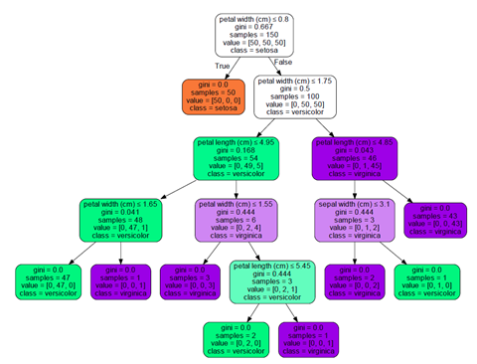
Decision Trees
https://pro.arcgis.com/en/pro-app/latest/tool-reference/geoai/how-decision-tree-classification-and-regression-works.htm

Slide 16
Decision Trees
Decision Trees are basically like flow charts
They have nodes and leaves
You follow the root of the tree down to the nodes and leaves, taking paths based on a value of a feature

Slide 17
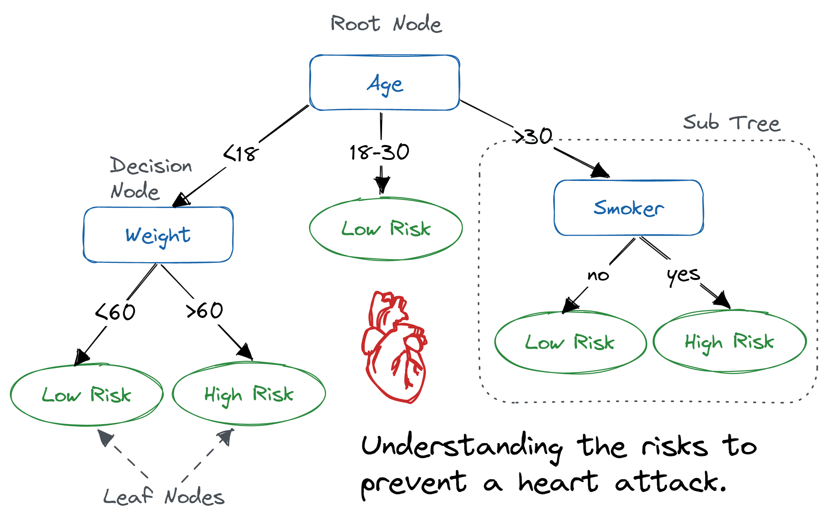
Example
https://www.datacamp.com/tutorial/decision-tree-classification-python

Slide 18
How do we create the trees?
We look for the best splits of the data to have efficient, useful trees
Basically all ways to split the data involve some aspect of information theory – like information gain or the gini index
Let's go through the example from here: https://kindsonthegenius.com/blog/how-to-build-a-decision-tree-for-classification-step-by-step-procedure-using-entropy-and-gain/

Slide 19
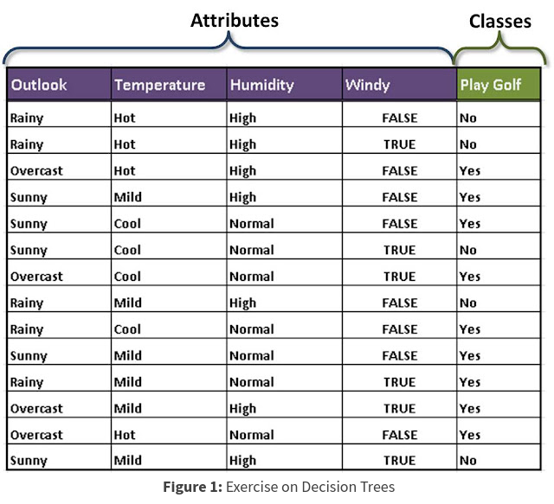
Golf Example from the Genius Blog
https://kindsonthegenius.com/blog/how-to-build-a-decision-tree-for-classification-step-by-step-procedure-using-entropy-and-gain/

Slide 20
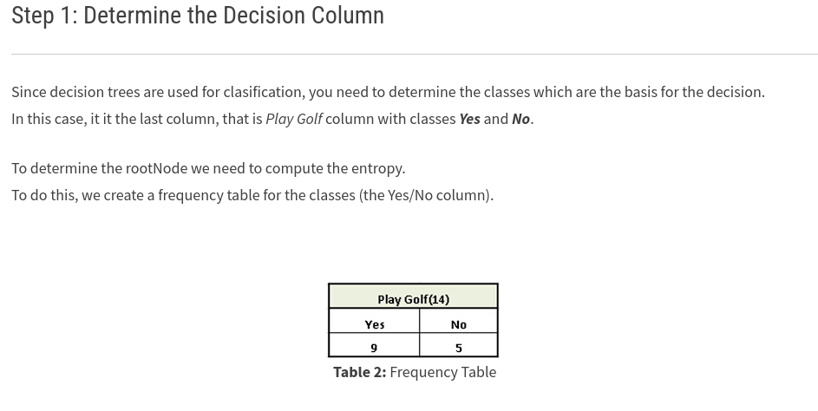
Golf Example from the Genius Blog
https://kindsonthegenius.com/blog/how-to-build-a-decision-tree-for-classification-step-by-step-procedure-using-entropy-and-gain/

Slide 21
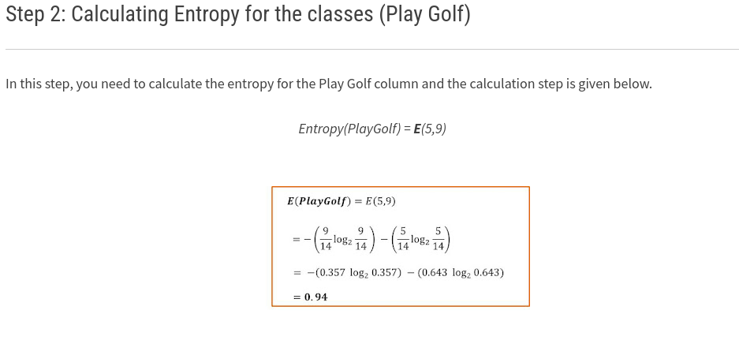
Golf Example from the Genius Blog
https://kindsonthegenius.com/blog/how-to-build-a-decision-tree-for-classification-step-by-step-procedure-using-entropy-and-gain/

Slide 22
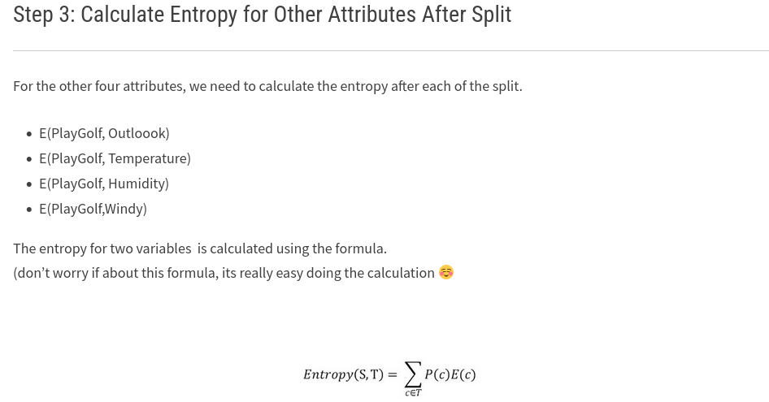
Golf Example from the Genius Blog
https://kindsonthegenius.com/blog/how-to-build-a-decision-tree-for-classification-step-by-step-procedure-using-entropy-and-gain/

Slide 23
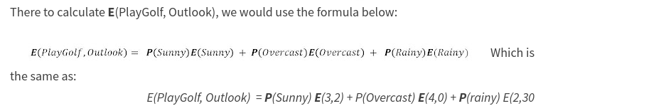
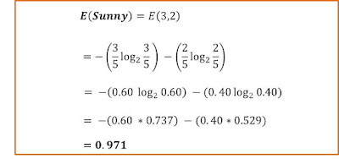
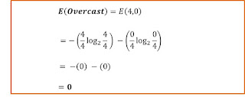
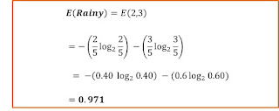
Golf Example from the Genius Blog
https://kindsonthegenius.com/blog/how-to-build-a-decision-tree-for-classification-step-by-step-procedure-using-entropy-and-gain/

Slide 24
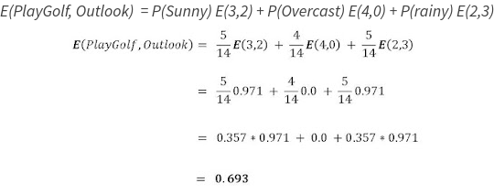
Golf Example from the Genius Blog
https://kindsonthegenius.com/blog/how-to-build-a-decision-tree-for-classification-step-by-step-procedure-using-entropy-and-gain/

Slide 25
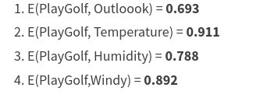
Golf Example from the Genius Blog
https://kindsonthegenius.com/blog/how-to-build-a-decision-tree-for-classification-step-by-step-procedure-using-entropy-and-gain/

Slide 26
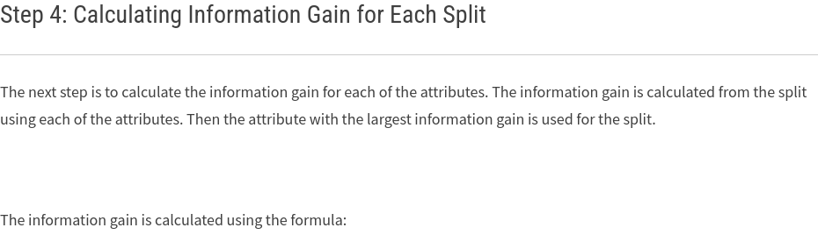
Golf Example from the Genius Blog
https://kindsonthegenius.com/blog/how-to-build-a-decision-tree-for-classification-step-by-step-procedure-using-entropy-and-gain/

Slide 27
Golf Example from the Genius Blog
https://kindsonthegenius.com/blog/how-to-build-a-decision-tree-for-classification-step-by-step-procedure-using-entropy-and-gain/

Slide 28
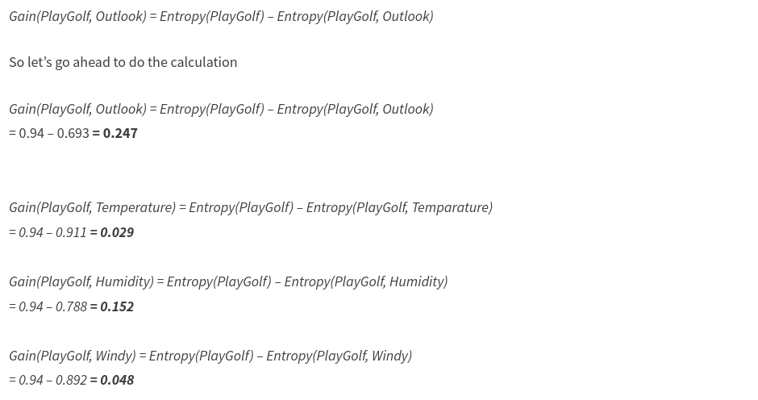
Golf Example from the Genius Blog
https://kindsonthegenius.com/blog/how-to-build-a-decision-tree-for-classification-step-by-step-procedure-using-entropy-and-gain/

Slide 29
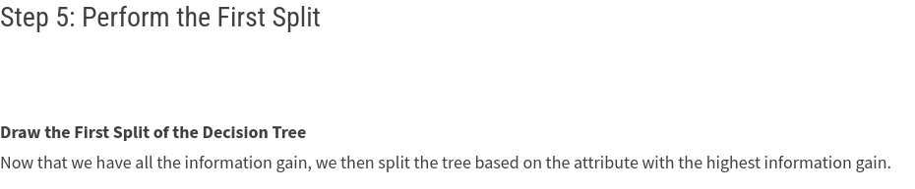
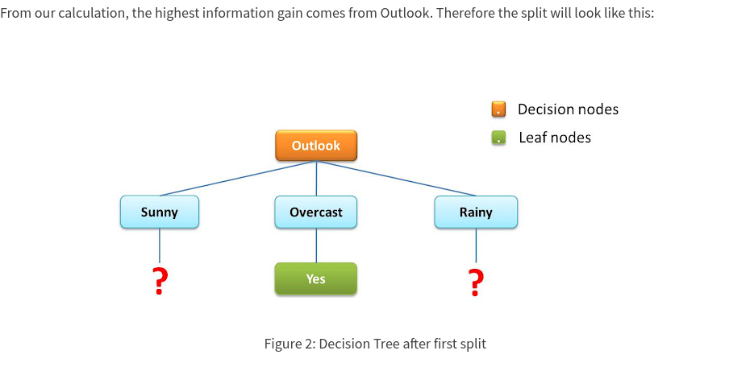
Golf Example from the Genius Blog
https://kindsonthegenius.com/blog/how-to-build-a-decision-tree-for-classification-step-by-step-procedure-using-entropy-and-gain/

Slide 30
Decision Trees
Keep splitting the tree based on values down through the nodes until you have split the categories or run out of nodes
For values that are continuous, arrange the values and generally find averages/midpoints to calculate around

Slide 31
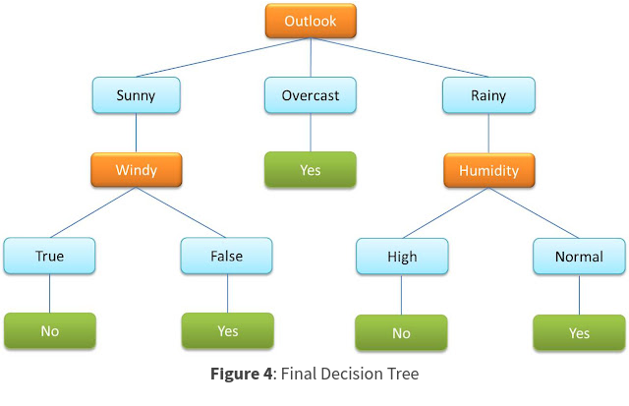
https://kindsonthegenius.com/blog/how-to-build-a-decision-tree-for-classification-step-by-step-procedure-using-entropy-and-gain/

Slide 32
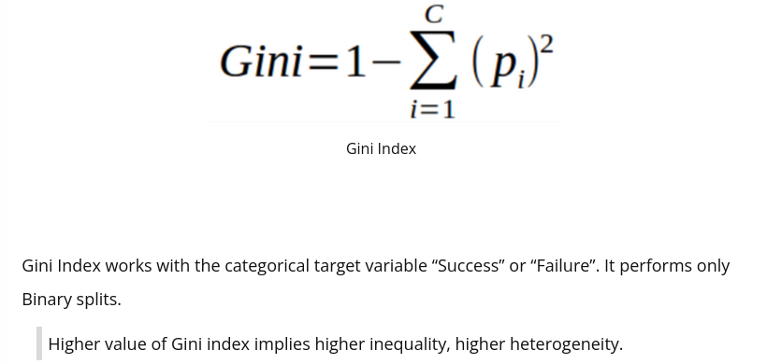
Gini Index
Can use instead of information gain
https://www.kdnuggets.com/2020/01/decision-tree-algorithm-explained.html

Slide 33
Decision Tree Advantages
Very easy to understand = explainable
Look at the lovely flowchart!
Can be very accurate
Intuitive

Slide 34
Decision Tree Disadvantages
Can overfit like mad
Not always great for very high dimensional data

Slide 35
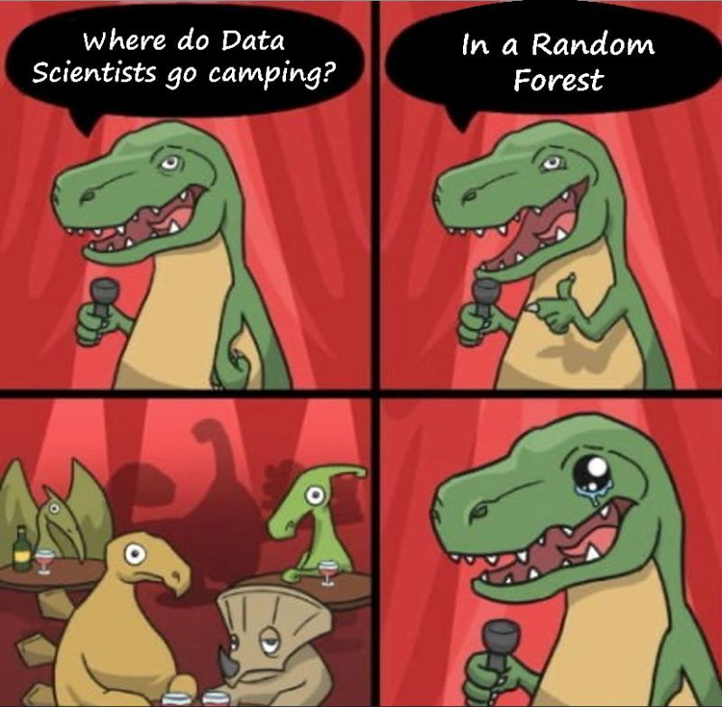
Improvements on Decision Tree
Pruning
Random Forest
https://www.linkedin.com/posts/watitap_this-is-hilarious-what-is-a-random-forest-activity-7060857693221097472-SETf

Slide 36
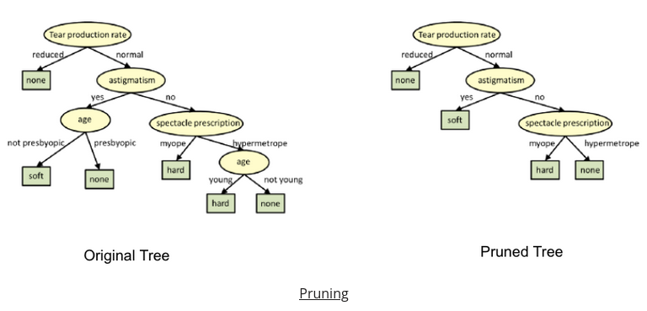
Pruning
Use your validation set to remove branches of the tree without killing accuracy
https://www.kdnuggets.com/2020/01/decision-tree-algorithm-explained.html

Slide 37
Random Forests
Train a BUNCH of decision trees
  Often only on a subset of the data
Average the answers together or use some weighting/voting system
This is an ensemble method
Can be very powerful!
Slightly less explainable than a typical decision tree
https://scikit-learn.org/stable/modules/generated/sklearn.ensemble.RandomForestClassifier.html

Slide 38
Let's Code!
Steel Dataset, as before -> prediction of defects

Slide 39
Back to Basics!
Dataset
Type of Machine Learning
Data Split
Model Evaluation

Slide 40
Back to Basics!
Dataset
  Steel Faults. Measurement features, defect classification outcomes
Type of Machine Learning
Data Split
Model Evaluation

Slide 41
Back to Basics!
Dataset
  Steel Faults. Measurement features, defect classification outcomes
Type of Machine Learning
  Supervised
Data Split
Model Evaluation

Slide 42
Back to Basics!
Dataset
  Steel Faults. Measurement features, defect classification outcomes
Type of Machine Learning
  Supervised
Data Split
  Train and Test Recommended
Model Evaluation

Slide 43
Back to Basics!
Dataset
  Steel Faults. Measurement features, defect classification outcomes
Type of Machine Learning
  Supervised
Data Split
  Train and Test Recommended
Model Evaluation
  Accuracy

Slide 44
When might you use a Decision Tree?
When you need a highly explainable model
When you have a small-ish dataset
When the dataset is highly related to management decisions or other analysis
When you have tabular data

Slide 45
When might you use a Random Forest?
When accuracy is an important tradeoff compared to explainability

Slide 46
Questions?

